Slide 1
Measuring tourism acceptance in Austria
Background, methodology and first results
Mr. Peter Laimer
Statistics Austria – Head Tourism Statistics Department
Ms. Rebecca Daul
Statistics Austria – Project Manager Travel behaviour and Tourism acceptance
First Webinar of the Tourism Sprint of the United Nations Network of Economic Statisticians – Tourism Statistics: Tools and Techniques for Data-Driven Decisions
24 September 2025 (virtual)

Slide 2



Tourism and Travel Statistics – Statistics Austria
Accommodation capacity
Arrivals & overnight stays
Travel behaviour
Domestic & outbound trips
Tourism acceptance
Accommodation statistics
Quarterly sample survey of residents
Income from inbound travel
Spending on outgoing travel
National TSA
Regional TSA
Travel Balance of Payments
Tourism Satellite Accounts

Slide 3
Agenda
Measuring tourism acceptance – why?
Methodology
Questionnaire
Analyses & results 2024
Small Area Estimation Model
Conclusions

Slide 4
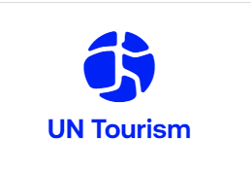
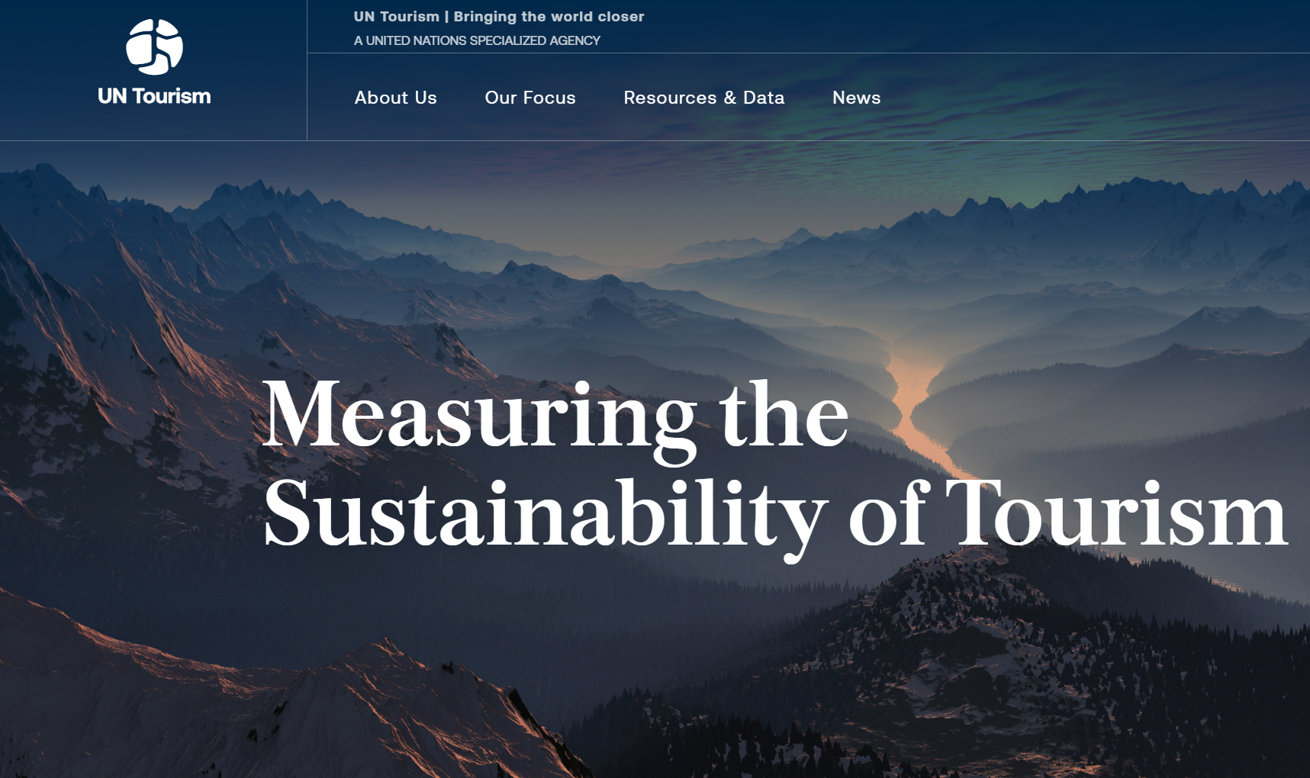
Measuring tourism acceptance – why? (1)
International standards
For years description and measurement of tourism solely by tourism flows and monetary contribution to economy → demand- and supply-side effects are perceived by local communities
Awareness to look beyond economic indicators to describe tourism → obtain holistic picture of the phenomenon of tourism
Under Austrian leadership, a "Statistical Framework for Measuring the Sustainability of Tourism" (SF-MST) was developed by UN Tourism, which is now the third statistical standard for tourism – after the “International Recommendations for Tourism Statistics” (IRTS) and the “Tourism Satellite Account” (TSA) – and valid for all UN member states.
With regard to “Measuring the host community perspective”, the SF-MST states: “... The collection of data on the perceptions and acceptance of host communities would generally be undertaken using surveys of residents..." (see paragraph 5.51).

Slide 5

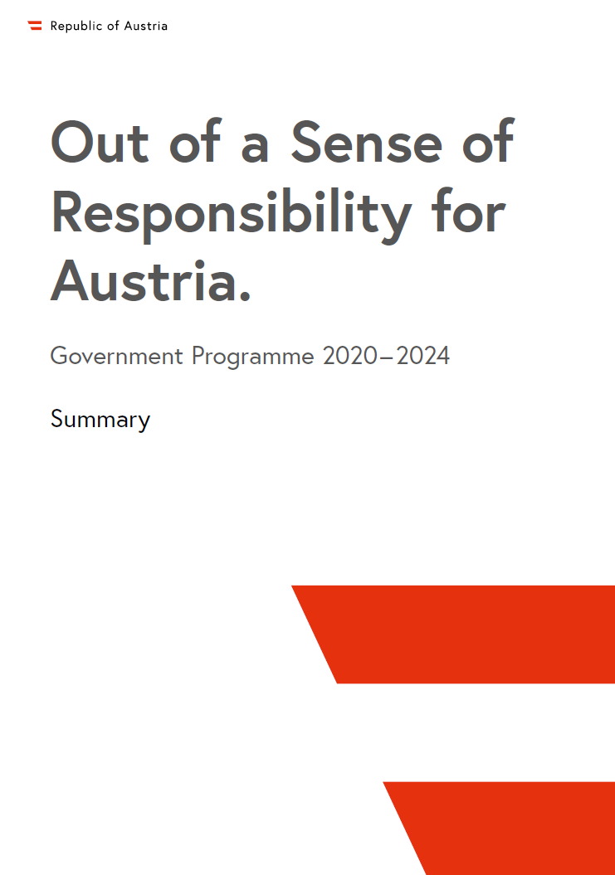
Measuring tourism acceptance – why? (2)
National road to tourism acceptance indicator
Plan T – Masterplan for Tourism 2019
  Development of sustainability indicators
  At this point no suitable indicator nationally or internationally for social pillar
Government programme 2020-2024 and 2025-2029
  Consideration of new or expanded surveys by Statistics Austria (and financial resources) to provide data basis for indicators that cover the entire value chain and impact on the population
  The results of the tourism acceptance measurement are regularly analyzed, including tourism policy measures to strengthen tourism acceptance
2020-2023: Extensive pilot studies on tourism acceptance by a private market research institute commissioned by the ministry
Beginning of 2024: Amendmend of tourism demand ordinance (legal basis for demand statistic/Travel behaviour) to include tourism acceptance

Slide 6
Agenda
Measuring tourism acceptance – why?
Methodology
Questionnaire
Analyses & results 2024
Small Area Estimation Model
Conclusions

Slide 7



Methodology Facts – How, who and when?
Tourism Acceptance – Add-on to tourism demand survey
How?
Who?
When?
Voluntary additional survey to the travel behaviour (tourism demand) survey and only for CAWI participants
ALL people in the sample are invited to complete the survey online
→ Only those who take part online are also asked about tourism acceptance.
Proportionally stratified random sample: people who live in Austria and are between 15 and 85 years old
Sample from the Central Register of Residents (ZMR): 15 000 people with their main place of residence in Austria
Goal net-sample: 3 000/quarter → 12 000/reporting year
Survey: Quarterly
always following a quarter, a person is surveyed (e.g. 1st quarter survey in April)
Results: Annually
On national and federal province level
Regional results possible, but limited
  Legislation: Decree of the Federal Minister of Labor and Economy on statistics on demand and acceptance in the tourism sector

Slide 8

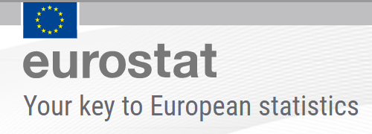
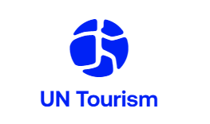


Data collection process
sampling
Postal invitation to Interview + reminder
Survey phase CAWI
Plausibility checks
weighting, grossing up
results

Slide 9
Agenda
Measuring tourism acceptance – why?
Methodology
Questionnaire
Analyses & results 2024
Small Area Estimation Model
Conclusions

Slide 10

Questionnaire in force (1)
Impact of tourism
Question G1
How do you personally rate the impact of tourism on your place of residence?
Please really only think of your place of residence/municipality of residence.
Predominantly positive (Filter to G1_1: Why?)
Rather positive
Neutral
Rather negative
Predominantly negative (Filter to G1_1: Why?)
Don’t know
→ Calculation of Tourism Acceptance Score (Place)
Question G1_1
Why do you rate the impact of tourism on where you live as predominantly positive/negative?
Please briefly explain the reason for your answer.

Slide 11
Questionnaire in force (2)
Perceived importance of tourism
Question G2_1
In your opinion, what importance does tourism (i.e. overnight and day trips) generally have for the economy, labour market and leisure activities in your place of residence?
Please really only think of your place of residence/municipality of residence.
High importance
Medium importance
Low importance
No importance (since 2025)
Don’t know
Question G2_2
In your opinion, what importance does tourism (i.e. overnight and day trips) generally have for the economy, labour market and leisure activities in Austria?
Please answer with your personal perception for the whole of Austria here.
High importance
Medium importance
Low importance
No importance (since 2025)
Don’t know

Slide 12
Questionnaire in force (3)
Perceived tourism intensity – risk of overtourism
Question G3_1
How do you personally feel about the number of tourists in your place of residence?
Please really only think of your place of residence/municipality of residence.
There are too few tourists.
There are rather few tourists.
The number of tourists is right for me.
There are rather many tourists. (Filter to G3_1_1: Seasonality)
There are too many tourists. (Filter to G3_1_1: Seasonality)
Don't know
Question G3_1_1 Seasonality
When do you feel that there are rather many/too many tourists in your place of residence? Multiple answers possible
All year round
In spring
In summer
In autumn
In winter
On other occasions (e.g. events)
Never (Warning: Are you sure? You have said before that you think Answer of G3_1 in your place of residence.)
Don’t know

Slide 13
Questionnaire in force (4)
Perceived tourism intensity / Occupational dependency
Question G3_2
How do you personally feel about the number of tourists in Austria overall?
Please answer with your personal perception for the whole of Austria here.
There are too few tourists.
There are rather few tourists.
The number of tourists is right for me.
There are rather many tourists.
There are too many tourists.
Don't know
Question G4
What importance does tourism have for your professional or financial situation?
Please think about where your income comes from.
Very high importance
High importance
Medium importance
Low importance
No importance at all
Don’t know

Slide 14
Agenda
Measuring tourism acceptance – why?
Methodology
Questionnaire
Analyses & results 2024
Small Area Estimation Model
Conclusions

Slide 15
45% have positive perception of tourism
Sum of positive perceptions: 45%
Sum of negative perceptions: 7%
Tourism Acceptance Score (TAS)¹: +38%-Points
(= Sum of positive perceptions – sum of negative perceptions)
S: STATISTICS AUSTRIA, Tourism acceptance 2024. – Rounding errors were not corrected.
1) Schmücker, D. & Eisenstein, B. (2021). Tourismusakzeptanz in der Wohnbevölkerung – Messmethode und Ergebnisse. Berichte Geographie und Landeskunde 94, 2021(3), 206-224. https://doi.org/10.25162/BGL-2021-0011
Question: How do you personally rate the impact of tourism on your place of residence?

Slide 16


Why is tourism perceived positively or negatively?
Economy
Employ-ment
Revitalising the town
Volume of traffic
Too many people
Price increase
More offers
Advertising
Cultural exchange
Noise pollution
Loss of authenticity
Environmental/Natural impact
Maintainingthe offers
Infra-structure
…
Con-struction
Loss of living space
…
S: STATISTICS AUSTRIA, Tourism acceptance 2024. Positive sssociations: n = 2 198, negative associations: n = 208
Question: How do you personally rate the impact of tourism on your place of residence?
Notes:
The main reason for a predominantly positive perception includes the strengthening of the economy, the creation of jobs, the revitalisation of the place of residence and cultural exchange. Conversely, tourism is mainly perceived negatively due to the increased volume of traffic, the (excessive) number of guests or the price increases associated with higher demand.

Slide 17
Three quarters see tourism as important for Austria
S: STATISTICS AUSTRIA, Tourism acceptance 2024. – Rounding errors were not corrected.
Question: In your opinion, what significance does tourism (i.e. overnight and day trips) generally have for the economy, labour market and leisure activities in your place of residence?
Question: : In your opinion, what significance does tourism (i.e. overnight and day trips) generally have for the economy, labour market and leisure activities in Austria?
Notes:
In 2024, a total of four in ten (40%) people living in Austria stated that tourism is very important for the economy, the labour market and leisure activities in their place of residence. For Austria as a whole, the proportion of the population who consider tourism to be very important for these areas is just under three quarters (73%).

Slide 18
Number of tourists is too high for 6% of the population
S: STATISTICS AUSTRIA, Tourism acceptance 2024. – Rounding errors were not corrected.
Question: How do you personally feel about the number of tourists in your place of residence?
Question: How do you personally feel about the number of tourists in Austria overall?
Notes:
Another characteristic of the population’s acceptance of tourism is their perception of the volume of tourists at their own place of residence and in Austria as a whole. In 2024, 65% of the Austrian population stated that the number of guests both at their place of residence and nationwide was “appropriate”. 15% of the population felt that the number of tourists in their own municipality was “rather high” and only 6% felt it was “too high”.

Slide 19
Acceptance of tourism varies depending on place and season
S: STATISTICS AUSTRIA, Tourism acceptance 2024. – Multiple answers possible. – The basis for calculating the percentages is the proportion of the population that felt there were „rather many“ or „too many“ tourists in their place of residence. – Rounding errors were not corrected.
Question: When do you feel that there are rather many/too many tourists in your place of residence?

Slide 20
For 5% tourism is of very high economic importance
The survey results roughly correspond to the proportion of people employed in the tourism industry –
TSA 2023: 5,1%
S: STATISTICS AUSTRIA, Tourism acceptance 2024, Tourism satellite accounts for Austria. – Rounding errors were not corrected.
Question: What importance does tourism have for your professional or financial situation?
Notes:
The perceived importance of tourism for one’s own place of residence is also significantly related to the perceived professional or financial dependence on tourism. 5% of the Austrian population in 2024 considered tourism to be of very high importance for their own professional or financial situation, while a further 7% considered it to be very important. This showed that if the importance of tourism for one’s own professional or financial situation is rated higher, the importance of tourism locally (at the place of residence) is also rated more favourably.

Slide 21
Agenda
Measuring tourism acceptance – why?
Methodology
Questionnaire
Analyses & results 2024
Small Area Estimation Model
Conclusions

Slide 22
Small Area Estimation Model (SAE)
Tourism Acceptance Score per municipality
Based solely on the sample, only federal province results are possible
→ Development of an estimation model for municipality data (machine-learning)
Input data:
  Perceived impact of tourism in the place of residence (according to the survey)
  Personal data (gender, whether born in Austria, Austrian citizenship, federal province, education, age, income, occupation in tourism)
  Municipality data (average income of the municipality, employees and turnover in tourism per inhabitant & municipality, overnight stays and establishments according to accommodation statistics)
Estimation from responses from persons not included in the sample & aggregation at municipal level:
Share of persons who perceive the effects as predominantly or rather positive
Share of persons who perceive the effects as predominantly or rather negative
Share of persons who are neutral about the effects
→ Calculation of the estimated Tourism Acceptance Score (TAS) per municipality

Slide 23
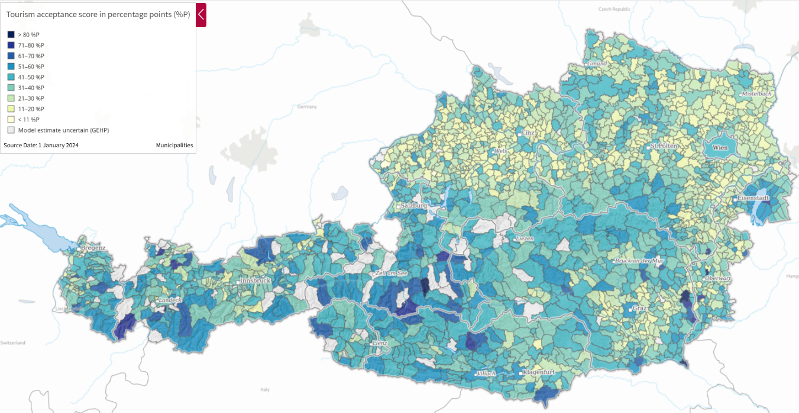
STATatlas: Acceptance of tourism on municipality level
S: STATISTICS AUSTRIA, Tourism acceptance 2024. – Estimated Tourism Acceptance Score based on a Small Area Estimation Modells.
Question: How do you personally feel about the number of tourists in your place of residence?

Slide 24

Conclusions
Example for how tourism acceptance can be surveyed with few variables and little additional effort and cost (on national and regional level)
  First data collection on social sustainability on legal basis
→ transparency
→ ongoing and stable data collection allowing timeline evaluations
  Good to have best practices in the industry to follow (e.g. German Institute for Tourism Research, NIT)
Positive response and feedback from the population
Satisfied data users (especially with the possibility of regional data by reweighing the sample)
Data so far paints positive picture of the tourism acceptance in Austria in 2024
→ Development of 2025 results will be vital to examine
Not a set in stone survey or topic, so we evaluate the feedback and questionnaire repeatedly

Slide 25
peter.laimer@statistik.gv.at
rebecca.daul@statistik.gv.at
Further information related to the Survey:
https://www.statistik.at/en/statistics/tourism-and-transport/tourism/tourism-acceptance

